Slide 1
INTERFACING WITH 8051

Slide 2
ADC INTERFACING WITH 8051
The analog sensors output data in an analog format which a microcontroller cannot understand. Therefore, to convert this analog data to a digital format, Analog to Digital converters or ADCs are used.
An analog signal has a continuously changing amplitude with respect to time. A digital signal, on the contrary, is a stream of 0s and 1s.
An ADC maps analog signals to their binary equivalents. To do this, ADCs use various methods like Flash conversion, slope integration, or successive approximation.

Slide 3
An input signal which varies from 0 to 8 volt,
use a 3-bit ADC to convert this signal to binary data.
A 3-bit ADC can represent 2^3 or 8 different voltage levels using 3 bits of data.
Input voltage | Binary equivalent
0-1 volt | 000B
1-2 volt | 001B
2-3volt | 010B
3-4 volt | 011B
4-5 volt | 100B
5-6 volt | 101B
6-7 volt | 110B
7-8 volt | 111B

Slide 4
Input voltage | Binary equivalent
0-1 volt | 000B
1-2 volt | 001B
2-3volt | 010B
3-4 volt | 011B
4-5 volt | 100B
5-6 volt | 101B
6-7 volt | 110B
7-8 volt | 111B
The tiniest change we can detect is that of 1 volt. If the change is smaller than 1 volt, the ADC can’t detect it. This minimum change that an ADC can detect is known as the step size of the ADC.

Slide 5
Step size=Vmax-Vmin/2^{n}
(where n is the number of bits(resolution) of an ADC)
Number of bits | Number of steps | step size(mV)
8 | 256 | 5/256=19.53
10 | 1024 | 5/1024=4.88
12 | 4096 | 5/4096=1.2
16 | 65536 | 0.076 (precise conversion

Slide 6
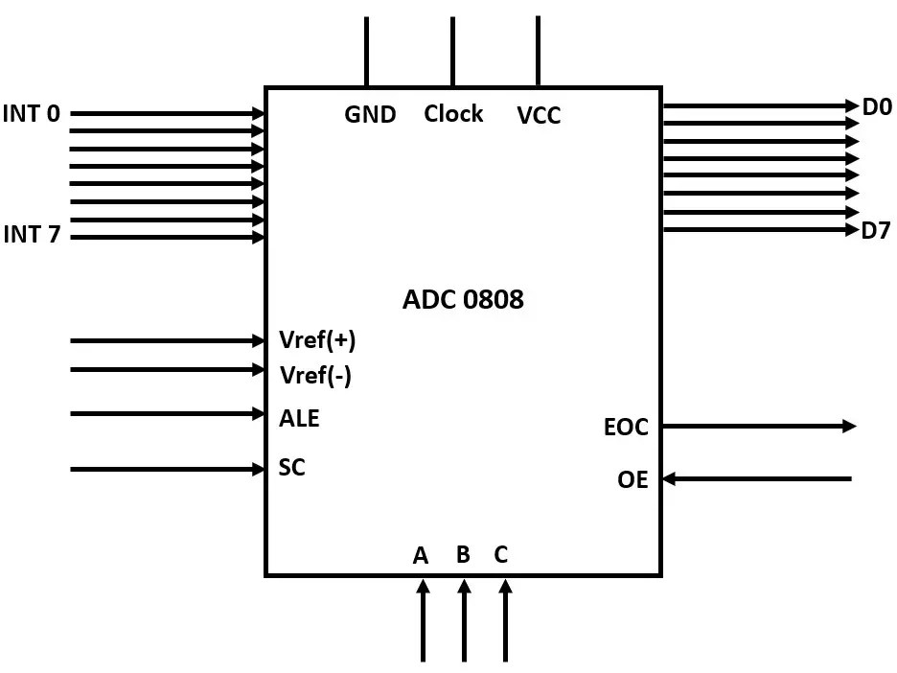
ADC 0808
The ADC 0808 is a popular 8-bit ADC with a step size of 19.53 millivolts.
It does not have an internal clock. Therefore, it requires a clock signal from an external source.
It has eight input pins, but only one of them can be selected at a time because it has eight digital output pins.
It uses the principle of successive approximation for calculating digital values, which is very accurate for performing 8-bit analog to digital conversions.

Slide 7
Input pins (INT0-INT7)
The ADC 0808 has eight input analog pins. These pins are multiplexed together, and only one of them can be selected using three select lines.
Select lines and ALE
It has three select lines, namely A, B, and C, that are used to select the desired input lines. The ALE pin also needs to be activated by a low to high pulse to select a particular input. The input lines are selected as follows:

Slide 8
A | B | C | Selected analog channel | ALE pin
0 | 0 | 0 | INT0 | Low to High pulse
0 | 0 | 1 | INT1 | Low to High pulse
0 | 1 | 0 | INT2 | Low to High pulse
0 | 1 | 1 | INT3 | Low to High pulse
1 | 0 | 0 | INT4 | Low to High pulse
1 | 0 | 1 | INT5 | Low to High pulse
1 | 1 | 0 | INT6 | Low to High pulse
1 | 1 | 1 | INT7 | Low to High pulse

Slide 9
Output pins (D0-D7)
The ADC has eight output pins that give the binary equivalent of a given analog value.
VCC and Ground
These two pins are used to provide the required voltage to power the microcontroller. In most cases, the ADC uses 5V DC to power up.
Clock
As mentioned earlier, the 0808 does not have an internal clock and needs an external clock signal to operate. It uses a clock frequency of 20Mhz, and using this clock frequency it can perform one conversion in 100 microseconds.
VREF (+) and VREF (-)
These two pins are used to provide the upper and the lower limit of voltages which determine the step size for the conversion. Here Vref(+) has a higher voltage, and Vref(-) has the lower voltage. If Vref(+) has an input voltage 5v and Vref(-) has a voltage of 0v then the step size will be 5v-0v/2⁸= 15.53 mv.

Slide 10
Start conversion
This pin is used to tell the ADC to start the conversion. When the ADC receives a low to high pulse on this pin, it starts converting the analog voltage on the selected pin to its 8-bit digital equivalent.
End of conversion
Once the conversion is complete, the ADC sends low to high signal to tell a microcontroller that the conversion is complete and that it can extract the data from the 8 data pins.
Output enable
This pin is used to extract the data from the ADC. A microcontroller sends a low to high pulse to the ADC to extract the data from its data buffers

Slide 11
Logic to communicate between 8051 and ADC 0808
Step 1: Set the port you connected to the output lines of the ADC as an input port.
Step 2: Make the Port connected to EOC pin high. The reason for doing this is that the ADC sends a high to low signal when the conversion of data is complete. So this line needs to be high so that the microcontroller can detect the change.
Step 3: Clear the data lines which are connected to pins ALE, START, and OE as all these pins require a Low to High pulse to get activated.
Step 4: Select the data lines according to the input port you want to select. To do this, select the data lines and send a High to Low pulse at the ALE pin to select the address.
Step 5: Now that we have selected the analog input pin, we can tell the ADC to start the conversion by sending a pulse to the START pin.
Step 6: Wait for the High to low signal by polling the EOC pin.
Step 7: Wait for the signal to get high again.
Step 8: Extract the converted data by sending a High to low signal to the OE pin.

Slide 12
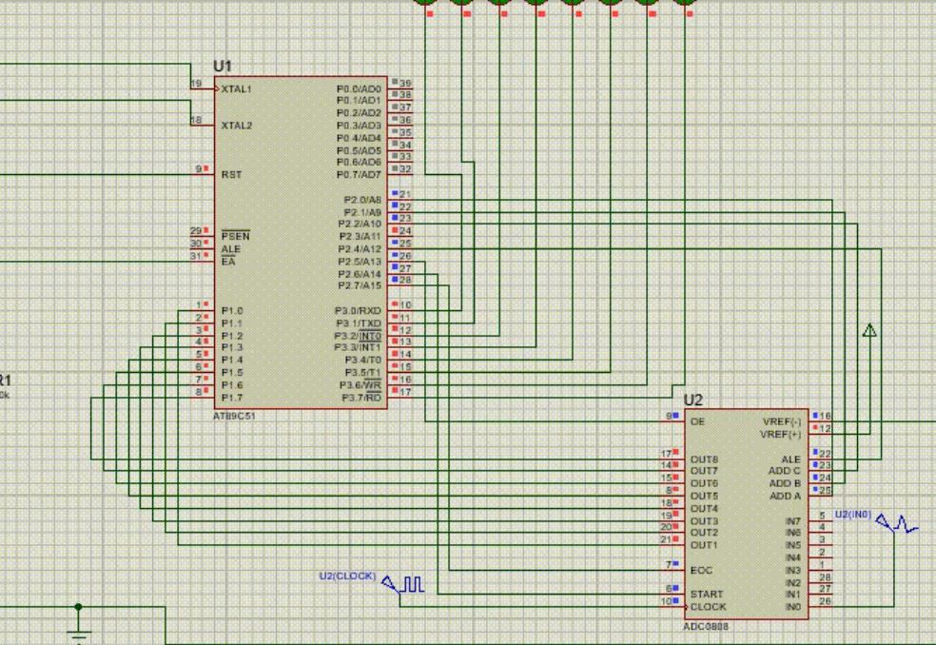

Slide 13
Interfacing_8051_with_0808-1.gif (872×602) (wp.com)

Slide 14
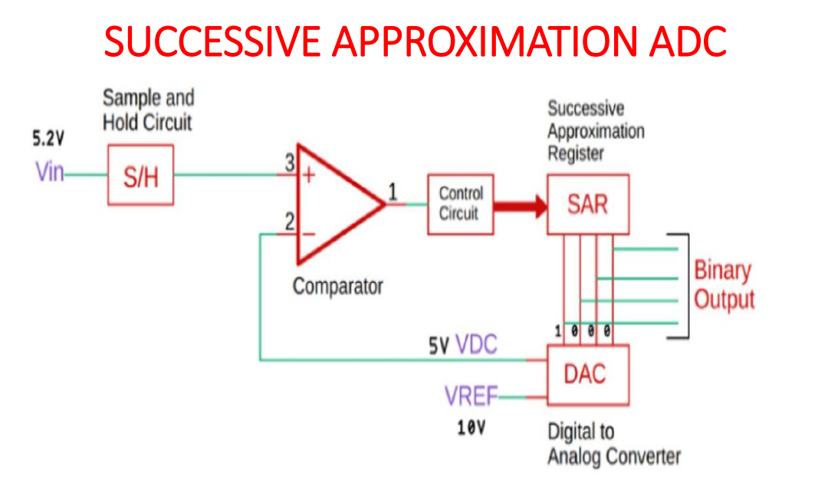

Slide 15
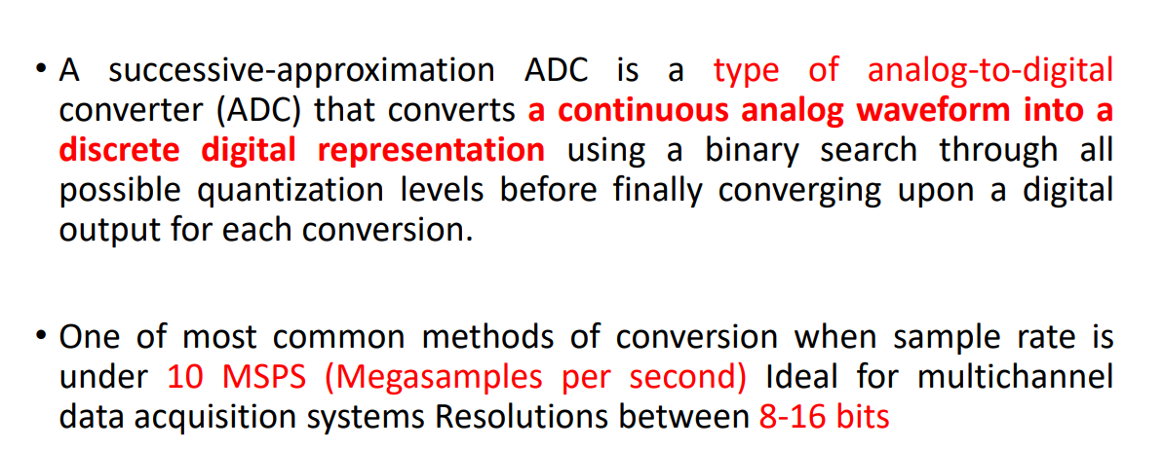

Slide 16
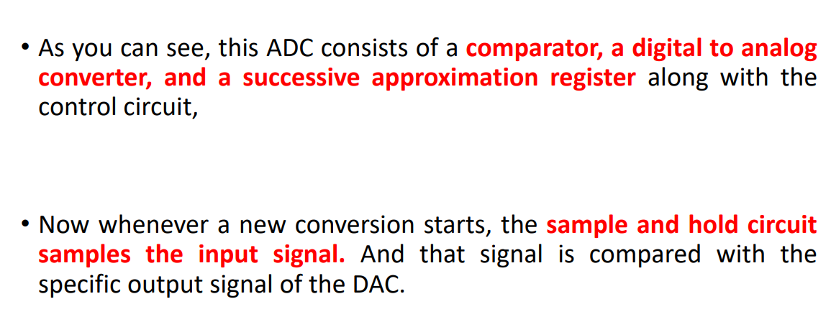

Slide 17
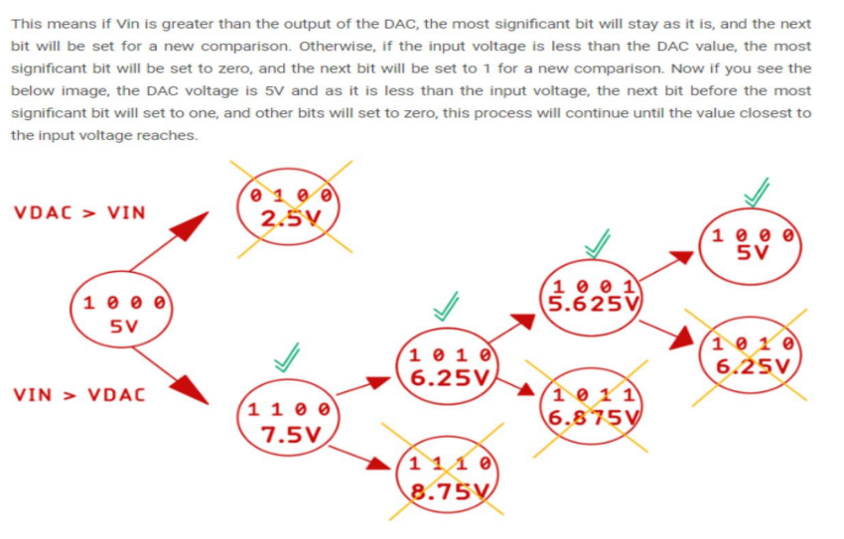

Slide 18


Slide 19
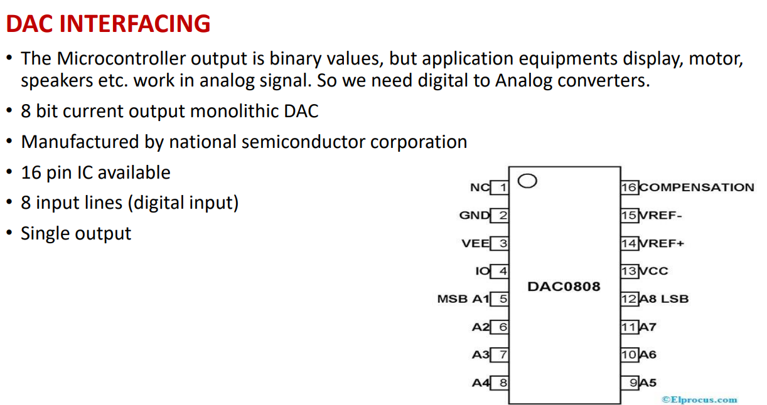

Slide 20
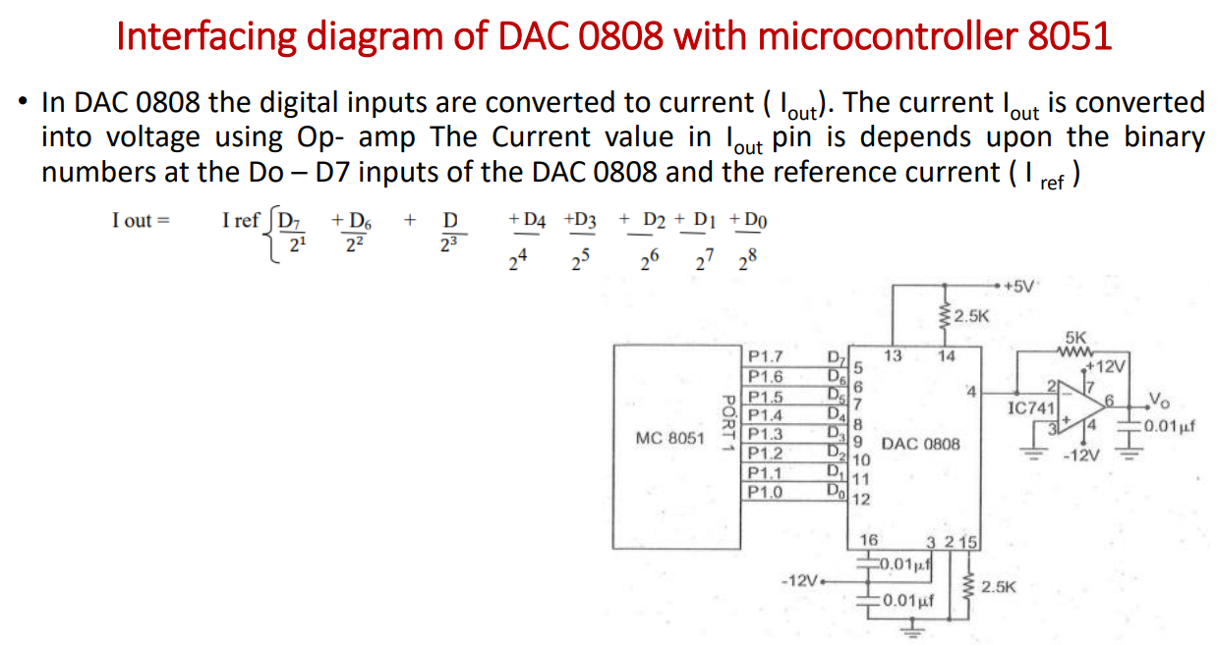

Slide 21
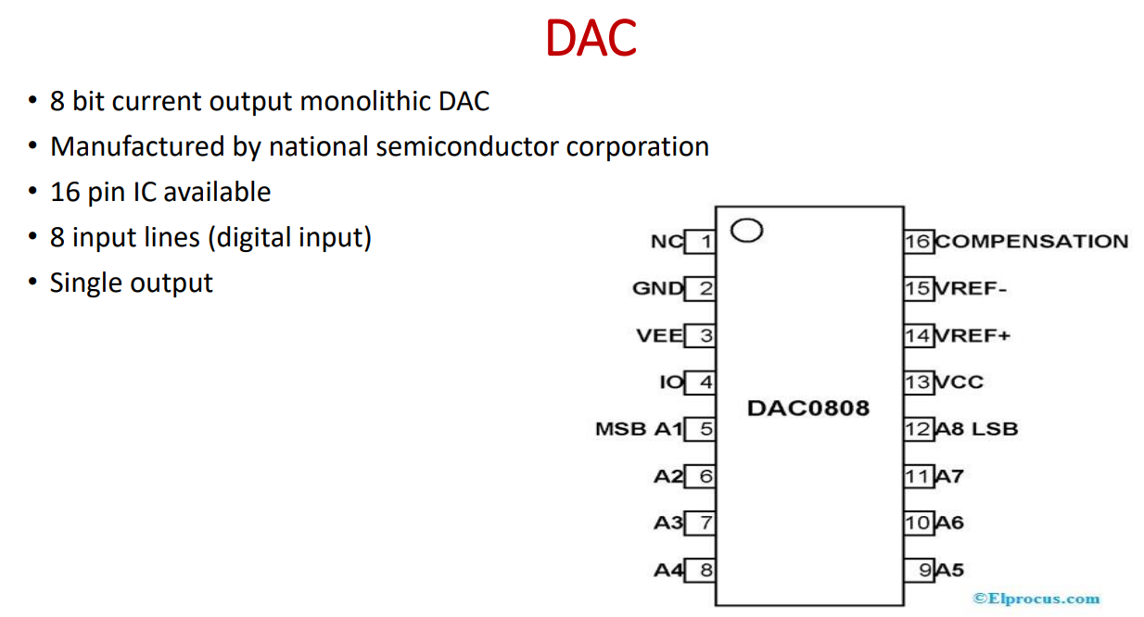

Slide 22
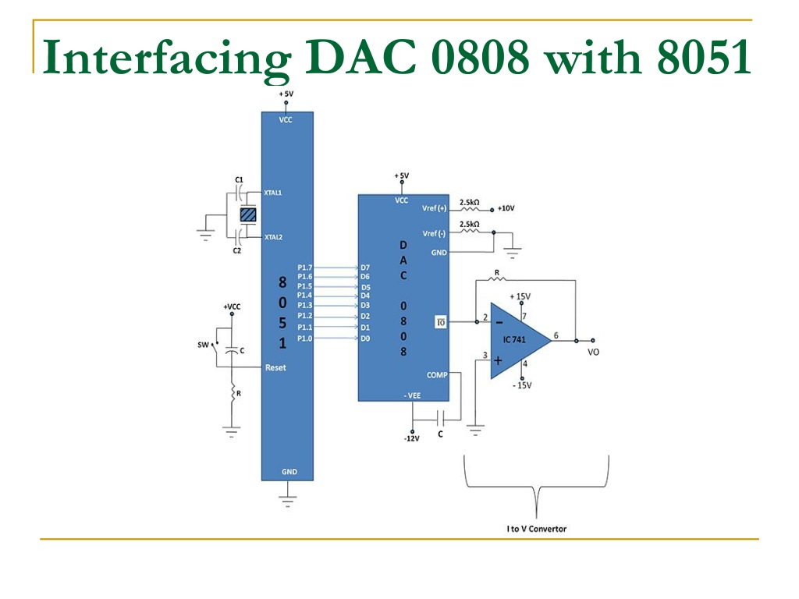

Slide 23
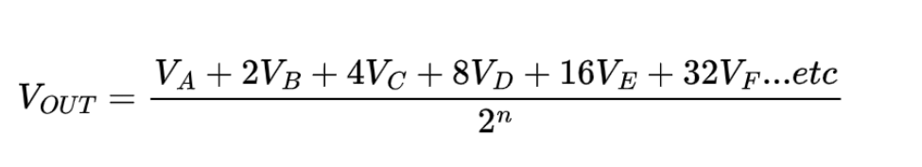
R 2R LADDER
The R-2R Digital-to-Analogue Converter is a type of data converter that transforms a digital binary number into an analog output signal that is proportionate to the value of the digital number using two precision resistor

Slide 24
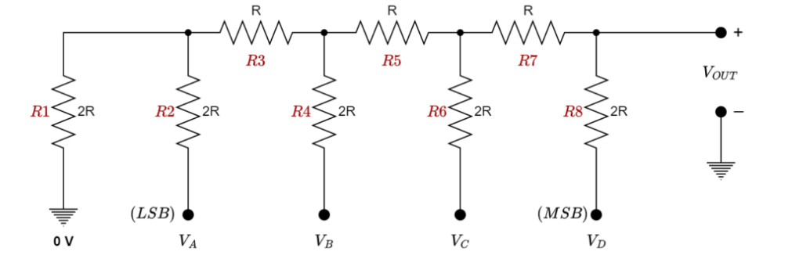
CIRCUIT DIAGRAM

Slide 25
